Slide 1
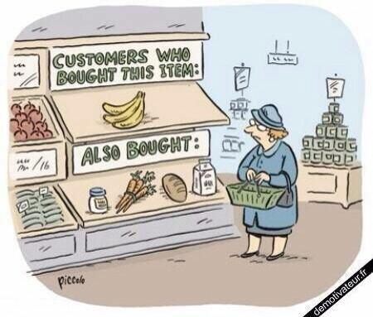
Content Recommendation System
Group Members:
ADIB MOHAMMED – 20201CSG0033
ABHINEET GAUR – 20201CSG0009
SURAJ KUMAR TRIPATHY – 20201CSG0030

Slide 2
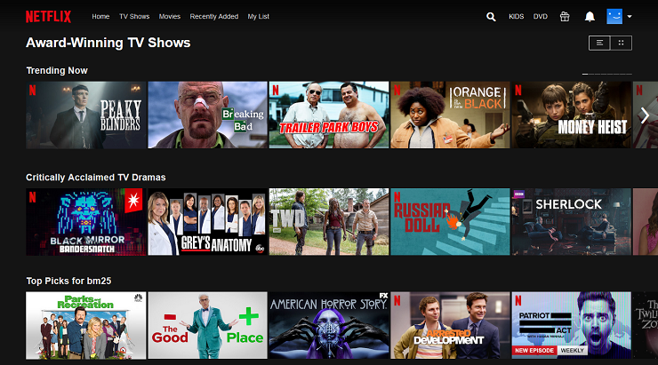
What is Recommendation System?
A recommendation system, also known as a recommender system, is a subclass of information filtering systems that are designed to predict or suggest items that a user might be interested in. Recommendation systems are widely used in various online platforms and applications to enhance user experience and engagement by providing personalized and relevant content. They are based on the idea of making suggestions or recommendations to users by analyzing their preferences and behavior.

Slide 3
Why recommendation system is useful for organization?
Increased Sales and Revenue: Recommendation systems significantly boost sales by suggesting relevant products to users, leading to increased revenue.
Enhanced User Engagement: Personalized recommendations keep users engaged, leading to higher satisfaction and longer time spent on the platform.
Data-Driven Insights: Recommendation systems generate valuable insights into user behavior, preferences, and trends, informing product development and marketing strategies.
Personalized Marketing: Organizations can target their marketing efforts more effectively, tailoring messages and offers based on user preferences and behavior.

Slide 4
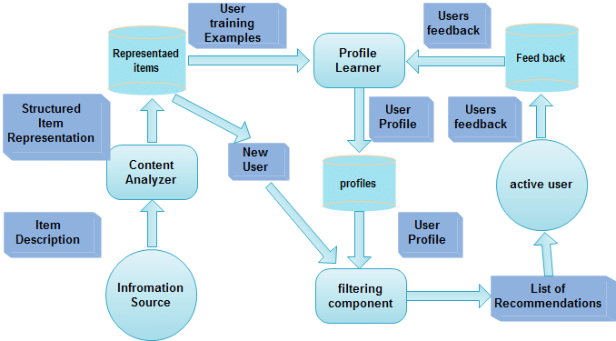
Architecture

Slide 5
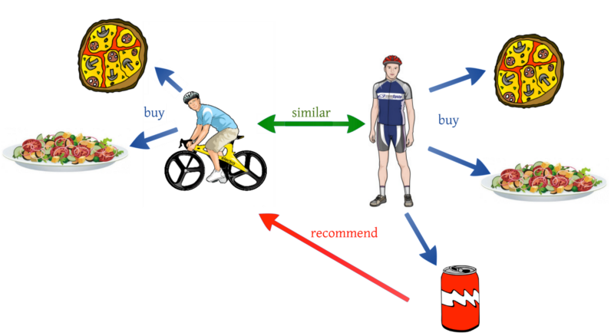
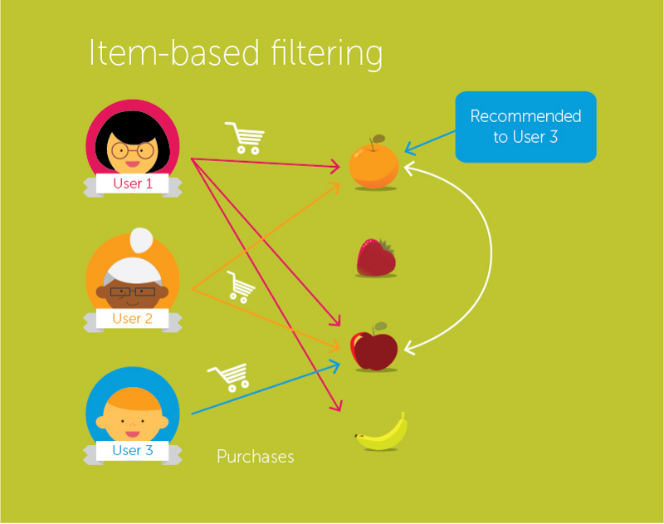
Model : Collaborative Filtering
User-User Collaborative Filtering :
1. User Similarity: Calculates similarity between users based on past interactions, using metrics like cosine similarity or Pearson correlation.
2. Similar User Group: Identifies users with similar preferences and behaviors to the target user, forming a group of potential recommenders.
3. Recommendations: Suggests items liked by similar users but not yet interacted with by the target user, promoting personalized content discovery.
Item-Item Collaborative Filtering:
1. Item Similarity: Measures how often items are interacted with by the same users to create an item-item similarity matrix.
2. Identifying User Interactions: Finds items the user has previously interacted with (e.g., rated, purchased) in the system.
3. Recommendations: Suggests items similar to those the user has already engaged with, leveraging item-item similarity for content relevance.

